Slide 1
Software process models
The waterfall model
Plan-driven model. Separate and distinct phases of specification and development.
Incremental development
Specification, development and validation are interleaved. May be plan-driven or agile.
Integration and configuration
The system is assembled from existing configurable components. May be plan-driven or agile.
In practice, most large systems are developed using a process that incorporates elements from all of these models.

Slide 2
Build-and-Fix Model
Problems
No specifications
No design
Totally unsatisfactory
High cost
Difficult maintenance

Slide 3
Waterfall Model
The waterfall model is a sequential design process in which progress is seen as flowing steadily downwards (like a waterfall) through the phases of SDLC.
Waterfall model is an example of a Sequential model.
In this model, the software development activity is divided into different phases and each phase consists of a series of tasks and has different objectives.
Waterfall model is the pioneer of the SDLC processes.
Characterized by:
Feedback loops
Documentation-driven

Slide 4
The waterfall model

Slide 5
Waterfall model phases
There are separate identified phases in the waterfall model:
Requirements analysis and definition
System and software design
Implementation and unit testing
Integration and system testing
Operation and maintenance
The main drawback of the waterfall model is the difficulty of accommodating change after the process is underway. In principle, a phase has to be complete before moving onto the next phase.

Slide 6
Waterfall Model (contd.)
Advantages
Enforces disciplined approach
Documentation for each phase
Products of each phase checked by SQA group
Maintenance is easier
Every change reflected in the relevant documentation
Disadvantages
Working version of the software will not be available until late in the project time-span
Specifications are long, detailed, written in a style unfamiliar to the client
“Blocking states” –some project team members must wait for other team members to complete dependent tasks

Slide 7
Waterfall model problems
Inflexible partitioning of the project into distinct stages makes it difficult to respond to changing customer requirements.
Therefore, this model is only appropriate when the requirements are well-understood and changes will be fairly limited during the design process.
Few business systems have stable requirements.
The waterfall model is mostly used for large systems engineering projects where a system is developed at several sites.
In those circumstances, the plan-driven nature of the waterfall model helps coordinate the work.

Slide 8
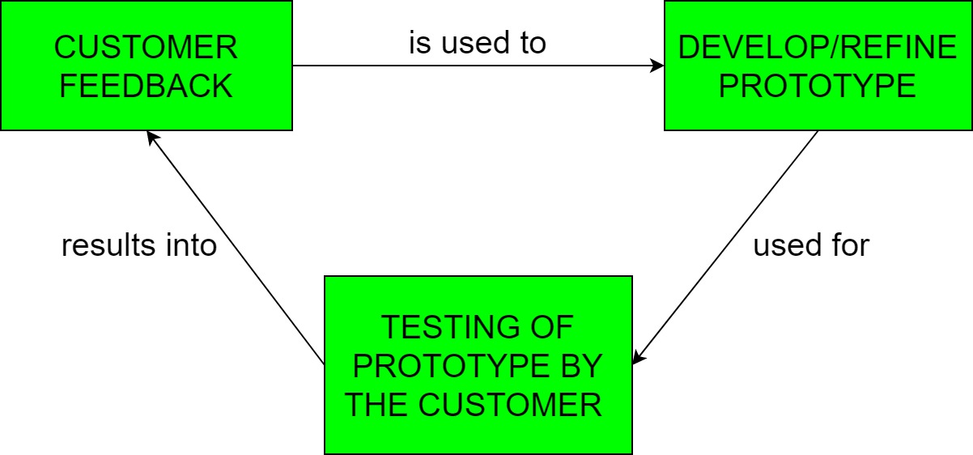
Rapid Prototyping Model
Prototyping is defined as the process of developing a working replication of a product or system that has to be engineered.
It offers a small scale replica of the end product and is used for obtaining customer feedback as described below:

Slide 9
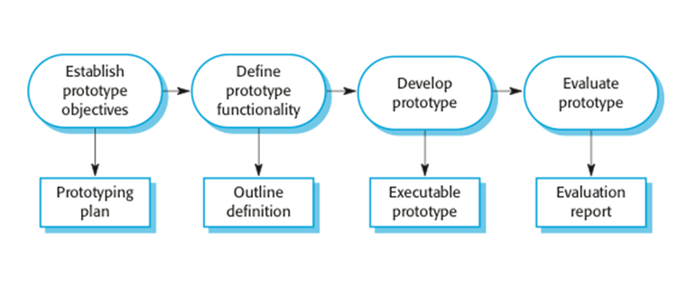
Rapid Prototyping Model (contd.)

Slide 10
Rapid Prototyping Model (contd.)
Rapid prototype characteristics:
Used in the requirements phase
Evaluated by the customer/user
Then, it is discarded -do not turn into product
Rapid prototyping model is not proven and has its own problems
Possible solution
Rapid prototyping for defining requirements
Waterfall model for rest of life cycle

Slide 11
Incremental Model
Incremental Model is a process of software development where requirements are broken down into multiple standalone modules of software development cycle.
Each iteration passes through the requirements, design, coding and testing phases.
Typical product takes from 5 to 25 builds (iterations).

Slide 12
Incremental development

Slide 13
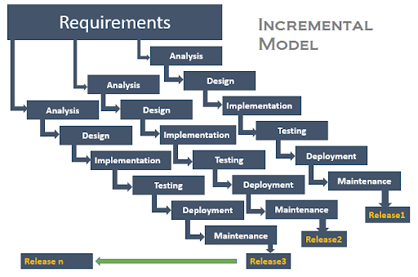
Incremental Model (contd.)

Slide 14
Incremental development benefits
The cost of accommodating changing customer requirements is reduced.
The amount of analysis and documentation that has to be redone is much less than is required with the waterfall model.
It is easier to get customer feedback on the development work that has been done.
Customers can comment on demonstrations of the software and see how much has been implemented.
More rapid delivery and deployment of useful software to the customer is possible.
Customers are able to use and gain value from the software earlier than is possible with a waterfall process.

Slide 15
Incremental development problems
The process is not visible.
Managers need regular deliverables to measure progress. If systems are developed quickly, it is not cost-effective to produce documents that reflect every version of the system.
System structure tends to degrade as new increments are added.
Unless time and money is spent on refactoring to improve the software, regular change tends to corrupt its structure. Incorporating further software changes becomes increasingly difficult and costly.

Slide 16
Incremental Model (contd.)
Waterfall and rapid prototyping models
Deliver complete product at the end
Incremental model
Deliver portion of the product at each stage
Advantages
The software will be generated quickly during the software life cycle
It is flexible and less expensive to change requirements and scope
Throughout the development stages changes can be done
This model is less costly compared to others
A customer can respond to each building
Errors are easy to be identified

Slide 17
Incremental Model (contd.)
Disadvantages:
It requires a good planning designing
Problems might arise due to system architecture as not all requirements collected up front for the entire software lifecycle
Each iteration phase is rigid and does not overlap each other
Correcting a problem in one unit requires correction in all the units and consumes a lot of time

Slide 18
When to use Incremental models?
Requirements of the system are clearly understood
When demand for an early release of a product arises
When software engineering team are not very well skilled or trained
When high-risk features and goals are involved
Such methodology is more in use for web application and product based companies

Slide 19
Spiral Model
The spiral model is a risk-driven software development process model.
Based on the unique risk patterns of a given project, the spiral model guides a team to adopt elements of one or more process models, such as incremental, waterfall, or evolutionary prototyping.
Risk Analysis: Identification of potential risk is done while risk mitigation strategy is planned and finalized
Precede each phase by
Alternatives
Risk analysis
Follow each phase by
Evaluation
Planning of next phase
Notes:
Examples of Software Risks include:
1- Estimation and scheduling
2- Sudden growth in requirements
3- Employee turnover
4- Productivity issues
5- Compromising on designs
6- Technical risks

Slide 20
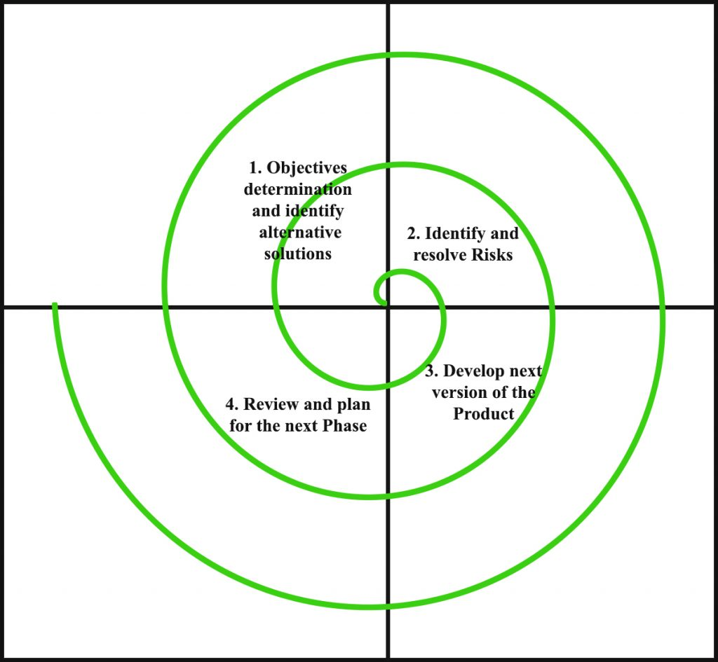
Simplified Spiral Model

Slide 21
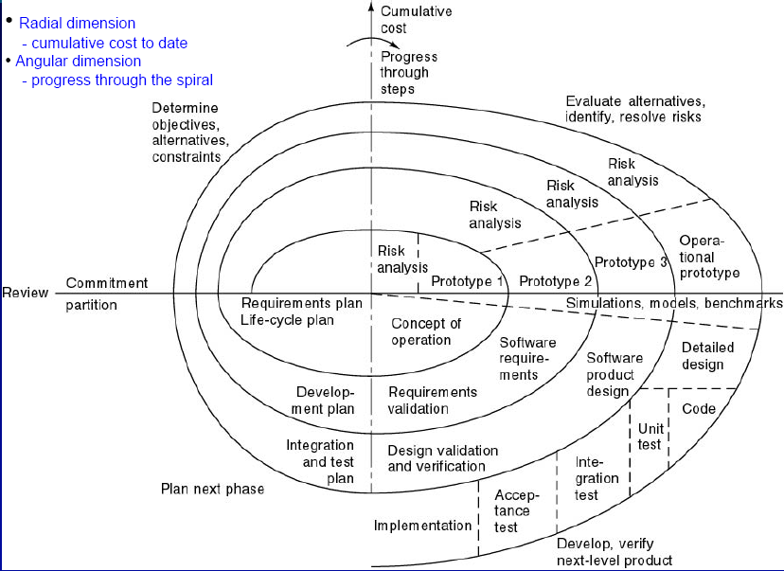
Full Spiral Model

Slide 22
When to use Spiral Methodology?
When project is large
When releases are required to be frequent
When creation of a prototype is applicable
When risk and costs evaluation is important
For medium to high-risk projects
When requirements are unclear and complex
When changes may require at any time
When long term project commitment is not feasible due to changes in economic priorities

Slide 23
Advantages of Spiral Model
Additional functionality or changes can be done at a later stage
Cost estimation becomes easy as the prototype building is done in small fragments
Continuous or repeated development helps in risk management
Development is fast and features are added in a systematic way
There is always a space for customer feedback

Slide 24
Disadvantages of Spiral Model
Risk of not meeting the schedule or budget
It works best for large projects only also demands risk assessment expertise
For its smooth operation spiral model protocol needs to be followed strictly
Documentation is more as it has intermediate phases
It is not advisable for smaller project, it might cost them a lot

Slide 25
Integration and configuration
Based on software reuse where systems are integrated from existing components or application systems (sometimes called COTS -Commercial-off-the-shelf) systems).
Reused elements may be configured to adapt their behaviour and functionality to a user’s requirements
Reuse is now the standard approach for building many types of business system

Slide 26
Types of reusable software
Stand-alone application systems (sometimes called COTS) that are configured for use in a particular environment.
Collections of objects that are developed as a package to be integrated with a component framework such as .NET.
Web services that are developed according to service standards and which are available for remote invocation.

Slide 27
Reuse-oriented software engineering

Slide 28
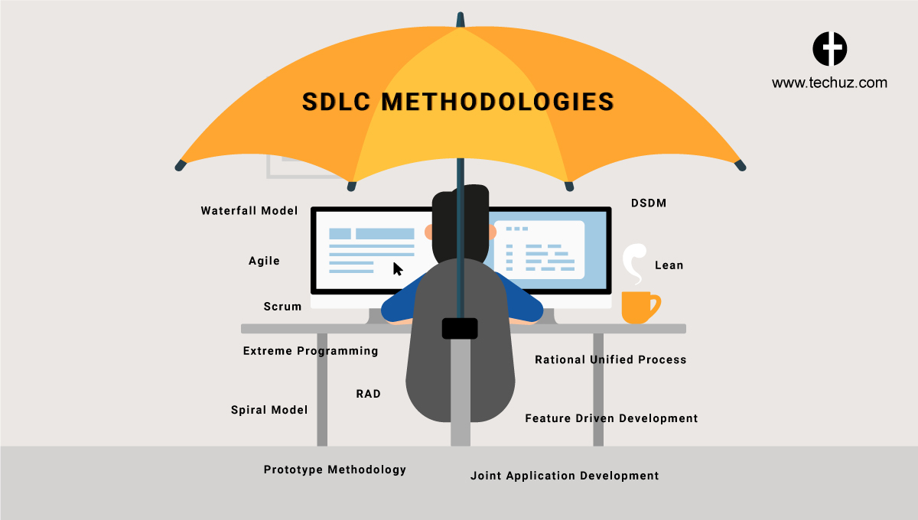
How to Choose between SDLC Methods?

Slide 29
How to Choose between SDLC Methods?
To know which is the best model out of all the different types of SDLC models, it is important to understand that each of these approaches are suitable for different projects, environments, and requirements.
For example, if your project is simple and straightforward with set requirements that do not need to be changed, then Waterfall is best suited for it.
However, if your project is large-scale and consists of multiple components and segments, then choosing Iterative or Spiral methodology would suit your project better.

Slide 30
How to Choose between SDLC Methods?
To answer the question simply, there is no ONE model is best from all the SDLC models discussed.
A preference of one method over the others cannot be determined.
However, to select the right SDLC methodologies, you should know all the types of SDLC models, assess the requirements of all the stakeholders and then decide on a method that best fits your needs.

Slide 31
Criteria for deciding on a model include
Criteria for deciding on a model include
Product Complexity
Product Size
Magnitude of Changes
Frequency of Changes
Skills of the Dev Team
Time constraints
Access to Users

Slide 32
Unified Process
Unified process is a framework for OO software engineering using UML (Unified Modeling Language)
Unified process (UP) is an attempt to draw on the best features and characteristics of conventional software process models, but characterize them in a way that implements many of the best principles of agile software development.

Slide 33
Unified Process Characteristics
It is an iterative and incremental development framework
It is architecture-centric with major work being done to define and validate an architectural design for most coding is done
It is risk-focused and emphasizes that highest-risk factors be addressed in the earliest deliverables possible
It is use-case and UML model driven with nearly all requirements being documented in one of those forms

Slide 34
Unified Process: Phases
Inception phase
Encompasses the customer communication and planning activities
Rough architecture, plan, preliminary use-cases
Elaboration phase
Encompasses the customer communication and modeling activities
Refines and expands preliminary use-cases
Expands architectural representation to include: use-case model, analysis model, design model, implementation model, and deployment model
The plan is carefully reviewed and modified if needed

Slide 35
Unified Process: Phases
Construction phase
Analysis and design models are completed to reflect the final version of the software increment
Using the architectural model as an input develop or acquire the software components, unit tests are designed and executed, integration activities are conducted
Use-cases are used to derive acceptance tests
Transition phase
Software is given to end-users for beta testing
User report both defects and necessary changes
Support information is created (e.g., user manuals, installation procedures)
Software increment becomes usable software release

Slide 36
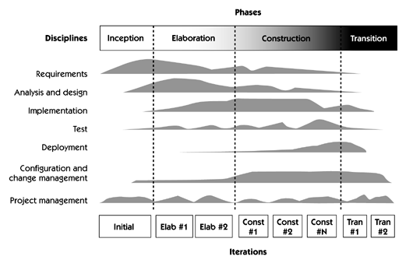
Unified Process Phases

Slide 37
